Slide 1
PacketShader: A GPU-Accelerated Software Router
Sangjin Han†
In collaboration with:
Keon Jang †, KyoungSoo Park‡, Sue Moon †
† Advanced Networking Lab, CS, KAIST ‡ Networked and Distributed Computing Systems Lab, EE, KAIST
Notes:
Hi, I am Sangjin Han, and I am going to present PacketShader, our GPU-accelerated software router.
This is joint work with Keon Jang, KyoungSoo Park, and Sue Moon.

Slide 2
PacketShader: A GPU-Accelerated Software Router
High-performance
Our prototype: 40 Gbps on a single box
Notes:
Let me explain what PacketShader is all about.
PacketShader is a software router that exploits GPU for high-performance data-path processing.
Our PacketShader prototype shows 40 Gbps forwarding performance on a single PC.

Slide 3
Software Router
Despite its name, not limited to IP routing
You can implement whatever you want on it.
Driven by software
Flexible
Friendly development environments
Based on commodity hardware
Cheap
Fast evolution
Notes:
I am going to give you some general ideas of software routers.
A software router is literally driven by software, so inherently flexible and programmable.
The role of software router is not limited to IP routing.
If you want more functionalities or support of new protocols, then you can just do it by modifying software.
Software routers are based on commodity hardware, which has two implications.
Commodity hardware is cheap and its evolution is fast because it is backed by millions of customers.

Slide 4
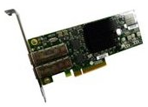
Now 10 Gigabit NIC is a commodity
From $200 – $300 per port
Great opportunity for software routers
Notes:
Now let’s review the commodity hardware market.
10 gigabit NICs have become popular and this is a great opportunity for software routers.
The cost of a 10 gigabit port is dropping quickly, and it is now below $300 per port.
You can build a multi-10G software router at a very affordable price.

Slide 5
Achilles’ Heel of Software Routers
Low performance
Due to CPU bottleneck
Year | Ref. | H/W | IPv4 Throughput
2008 | Egi et al. | Two quad-core CPUs | 3.5 Gbps
2008 | “Enhanced SR” Bolla et al. | Two quad-core CPUs | 4.2 Gbps
2009 | “RouteBricks” Dobrescu et al. | Two quad-core CPUs (2.8 GHz) | 8.7 Gbps
Not capable of supporting even a single 10G port
Notes:
However, a high-speed link at low cost does not guarantee the performance of software routers.
The Achiles’ heel of software routers has long been its low performance due to the CPU bottleneck.
The table in the slide shows the performance of software routers measured with 64-byte packets.
Many researchers have tried to push the performance to the limit, but it has not scaled beyond 10 Gbps.
It means that it doesn’t matter how many 10G ports you have,
your system will not be able to handle even a single port at a line rate.

Slide 6
CPU Bottleneck
Notes:
I told you that the performance bottleneck is in the CPU and I’m going to give you a little more details.

Slide 7
Per-Packet CPU Cycles for 10G
IPv4
1,200
+
600
= 1,800 cycles
Packet I/O
IPv4 lookup
Cycles needed
IPv6
1,200
+
1,600
= 2,800
5,400
Packet I/O
IPv6 lookup
IPsec
1,200
+
…
= 6,600
Packet I/O
Encryption and hashing
Your budget
1,400 cycles
10G, min-sized packets, dual quad-core 2.66GHz CPUs
(in x86, cycle numbers are from RouteBricks [Dobrescu09] and ours)
Notes:
Let’s see how much computation power is needed.
and why CPU-only approach is not enough for 10G networks.
First of all, you need 1,200 CPU cycles to receive and transmit every packet through network interface cards.
Furthermore, you need additional computation power depending on what you want to do on the software router.
The problem is that you don’t have enough CPU cycles.
How can we solve this problem?

Slide 8
Our Approach 1: I/O Optimization
1,200
+
600
= 1,800 cycles
Packet I/O
IPv4 lookup
1,200
+
1,600
= 2,800
5,400
Packet I/O
IPv6 lookup
1,200
+
…
= 6,600
Packet I/O
Encryption and hashing
1,200 reduced to 200 cycles per packet
Main ideas
Huge packet buffer
Batch processing
Packet I/O
Notes:
Our approach is twofold.
The first one is [click] to optimize packet I/O and we got significant improvement by a factor of 6.
I’m not going to address the details in this talk.
And you can find our optimization techniques, in the paper.

Slide 9
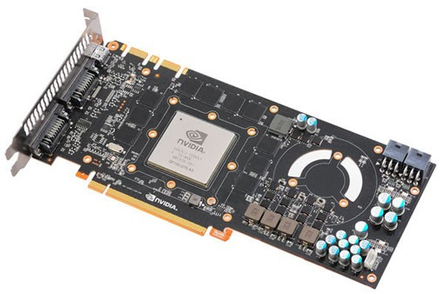
Our Approach 2: GPU Offloading
+
600
Packet I/O
IPv4 lookup
+
1,600
5,400
Packet I/O
IPv6 lookup
+
…
Packet I/O
Encryption and hashing
GPU Offloading for
Memory-intensive or
Compute-intensive operations
Main topic of this talk
Notes:
And our second approach is about how to handle these application-dependent operations in an effective way.
[click] Our solution is to offload those operations to GPU, and it is the main topic of this talk.

Slide 10
What Is GPU?
Notes:
I assume most of you are not familiar with GPU,
so let me introduce GPU briefly.

Slide 11
GPU = Graphics Processing Unit
The heart of graphics cards
Mainly used for real-time 3D game rendering
Massively-parallel processing capacity
(Ubisoft’s AVARTAR, from http://ubi.com)
Notes:
GPU is the central processor in a graphics card.
In order to synthesize realistic 3D graphics in real-time,
GPU handles millions of polygons and billions of pixels per second, on its massively-parallel architecture.
Software routers have nothing to do with graphics rendering, you know,
Then why am I introducing GPU to you guys?
Recently, GPU has been flexible and programmable enough for non-graphics workloads.
General purpose computation on GPU is increasingly popular, and basically this work is a novel application of GPU for software routers.

Slide 12
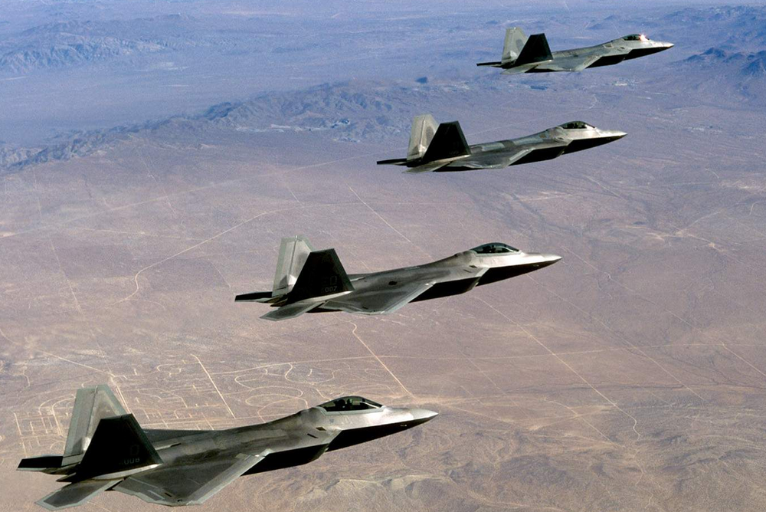
CPU vs. GPU
CPU:
Small # of super-fast cores
GPU:
Large # of small cores
Notes:
GPU architecture is different from that of general-purpose CPU.
Today’s CPU has a small number of cores, and each CPU core is quite fast.
In contrast, GPU has a large number of cores, and each GPU core is small and not as smart as CPU cores.
They don’t have some advanced features of CPU, such as out of order execution and dynamic branch prediction.
If you want to transport a few people in a short time, then CPU is the best option.
But if you want to transport many people, in other words if your workload is throughput-centric, then you should consider use of GPU.

Slide 13
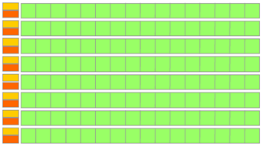
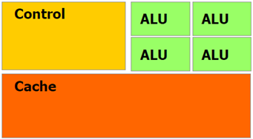
“Silicon Budget” in CPU and GPU
ALU
Xeon X5550: 4 cores 731M transistors
GTX480: 480 cores 3,200M transistors
Notes:
This difference comes from how transistors are composed in the processor.
CPU dedicates most of transistors to sophisticated execution control plane and large caches to accelerate single-threaded programs.
GPU has much more transistors, and most of the transistors are devoted to Arithmetic Logic Units,
and these Arithmetic Logic Units form a large array of GPU cores.
So if your workload has enough parallelism, you can expect significant throughput improvement with GPU.

Slide 14
GPU for Packet Processing
Notes:
Now let’s move on how we can utilize GPU for packet processing.

Slide 15
Advantages of GPU for Packet Processing
Raw computation power
Memory access latency
Memory bandwidth
Comparison between
Intel X5550 CPU
NVIDIA GTX480 GPU
Notes:
For packet processing, GPU can be a quite effective solution.
I am going to explain the advantages of GPU in terms of raw computation power, memory access latency, and memory bandwidth.

Slide 16
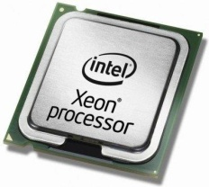
(1/3) Raw Computation Power
Compute-intensive operations in software routers
Hashing, encryption, pattern matching, network coding, compression, etc.
GPU can help!
Instructions/sec
<
CPU: 43×10⁹ = 2.66 (GHz) ×
4 (# of cores) ×
4 (4-way superscalar)
GPU: 672×10⁹ = 1.4 (GHz) ×
480 (# of cores)
Notes:
Software routers need lots of computation power.
Hashing, encryption, pattern matching, all these operations are computation hungry.
The good thing of GPU is that it has much higher computation power,
so you can adopt those compute-intensive operations in your software router.

Slide 17
(2/3) Memory Access Latency
Software router → lots of cache misses
GPU can effectively hide memory latency
Cache miss
Cache miss
GPU core
Switch to Thread 2
Switch to Thread 3
Notes:
And the second aspect is about memory access latency.
Software routers tend to do random memory access.
So your CPU will experience lots of cache misses, and thus wasting potential computation power.
In contrast, GPU can work around memory stall penalties.
When the GPU has a cache miss, then it switches to another thread that is immediately executable.
This context switching is done by hardware scheduler, so it does not cause any extra overheads.

Slide 18
(3/3) Memory Bandwidth
CPU’s memory bandwidth (theoretical): 32 GB/s
Notes:
The last thing I want to compare is memory bandwidth.
The memory bandwidth of top-of-the-line CPUs is 32 GB/s today.
This number is theoretical, and…[click]

Slide 19
(3/3) Memory Bandwidth
3. TX:
CPU → RAM
2. RX:
RAM → CPU
4. TX:
RAM → NIC
1. RX:
NIC → RAM
CPU’s memory bandwidth (empirical) < 25 GB/s
Notes:
depending on memory access pattern, you will get much less empirical memory bandwidth.
You can’t fully utilize even this number because you have many mouths to feed.
[click]
Basically reception and transmission of packets through NICs take a large amount of memory bandwidth.
If your software router forwards traffic at a certain rate, then the memory bandwidth consumption is more than four times that of line rate.

Slide 20
(3/3) Memory Bandwidth
Your budget for packet processing can be less 10 GB/s
Notes:
As a result, your budget for packet processing can be less than 10 GB/s on high speed networks,
Within the budget, you have to make forwarding decision or perform deep packet inspection for every packet.
The problem is that your remaining budget is not quite enough to handle such memory-intensive operations.

Slide 21
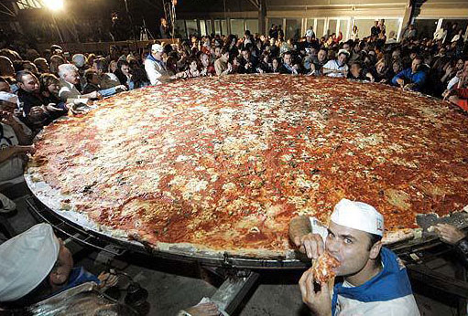
(3/3) Memory Bandwidth
Your budget for packet processing can be less 10 GB/s
GPU’s memory bandwidth: 174GB/s
Notes:
The good thing is that GPU has an order of magnitude higher memory bandwidth than that of CPU.
So if you offload memory-intensive operations to GPU, then you can secure enough memory bandwidth.
// 10 mins?

Slide 22
How to Use GPU
Notes:
So far, I have explained reasons WHY GPU can be useful for packet processing.
Now I am going to explain HOW TO USE GPU for packet processing.

Slide 23
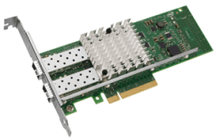
Basic Idea
Offload core operations to GPU (e.g., forwarding table lookup)
Notes:
The basic idea of using GPU in software routers is very simple.
The CPU’s role of receiving and transmitting packets through NICs remains as traditional software routers.
The difference is that we offload core operations to GPU.
Such operations could be, for example, forwarding table lookup, encryption or anything that requires much processing power.

Slide 24
Recap
For GPU, more parallelism, more throughput
GTX480: 480 cores
Notes:
One thing you have to consider is, as I said before, GPU is basically for parallel processing.
For optimal performance you must feed enough parallelism to GPU,
otherwise GPU is going to be under-utilized, so you can’t expect any performance advantages over CPU.

Slide 25
Parallelism in Packet Processing
The key insight
Stateless packet processing = parallelizable
RX queue
2. Parallel Processing in GPU
1. Batching
Notes:
Then where can we find such parallelism in packet processing?
We can take multiple packets from RX queues in a batch, not one-by-one, and process them in parallel.
The key insight behind this work is that stateless packet processing is easily parallelizable by definition.
You don’t need any coordination between packets for parallel processing.

Slide 26
Batching → Long Latency?
Fast link = enough # of packets in a small time window
10 GbE link
up to 1,000 packets only in 67μs
Much less time with 40 or 100 GbE
Notes:
Some of you might worry that accumulating hundreds of packet may induce unreasonable delay.
Our answer to the question is that it’s not true.
For example, on a fully saturated 10G link you can gather up to one thousand packets only in 67 microseconds.

Slide 27
PacketShader Design
Notes:
Now let’s move on the detailed architecture of PacketShader.

Slide 28
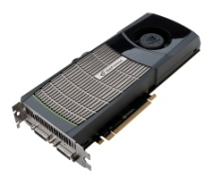
Basic Design
Three stages in a streamline
Pre-shader
Shader
Post-shader
Notes:
PacketShader’s basic design is very simple.
The packet processing is done in three stages, pre-shader, shader, and post-shader.
And I’m going to explain how each stage works.

Slide 29
Packet’s Journey (1/3)
IPv4 forwarding example
Checksum, TTL
Format check
…
Collected dst. IP addrs
Pre-shader
Shader
Post-shader
Some packets go to slow-path
Notes:
This is an example of IPv4 forwarding.
Once packets are received in a batch, the pre-shader stage performs some pre-processing of the packets
such as checksum and TTL check or whatever.
Some packets that need slow-path processing go to the default TCP/IP stack of the Operating System.
For the remaining packets, Pre-shader collects the destination IP addresses of the packets and pass them to the shader stage.

Slide 30
Packet’s Journey (2/3)
IPv4 forwarding example
2. Forwarding table lookup
1. IP addresses
3. Next hops
Pre-shader
Shader
Post-shader
Notes:
In the shader stage, the collected IP addresses are copied to the GPU,
and the GPU performs forwarding table lookup in parallel,
and finally the resulting next hop information is delivered back to the CPU again.

Slide 31
Packet’s Journey (3/3)
IPv4 forwarding example
Update packets and transmit
Pre-shader
Shader
Post-shader
Notes:
Finally in the post-shader stage,
the packets are updated and transmitted through output ports, based on the forwarding decision result.

Slide 32
Interfacing with NICs
Packet RX
Packet TX
Device driver
Pre-shader
Shader
Post-shader
Device driver
Notes:
For simplicity I omitted the device driver in the previous slides,
But of course you need an interface to communicate with network interface cards as in the figure.
We implemented our own device driver for optimal performance, and you can find some details in the paper.
[잠깐 쉬고]
So far, we have seen the basic design of PacketShader.
But things become a little more complicated because of some challenges behind today’s commodity PC architecture.

Slide 33
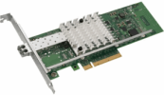
Scaling with a Multi-Core CPU
Master core
Shader
Device driver
Pre-shader
Post-shader
Device driver
Worker cores
Notes:
The first challenge comes from adoption of a multi-core CPU.
Recent CPUs have multiple cores in the die.
Each core must run as independently as possible in order to achieve linear scalability with the number of cores.
So, we duplicated the basic streamline across multiple cores, as shown in the slide.
Another choice we made is to dedicate one CPU core as a master core, which communicates with the GPU.
When multiple cores contend for the same GPU, the system performance significantly drops due to context switching overheads.
And this is the reason why we have only one master core in the CPU.

Slide 34
Scaling with Multiple Multi-Core CPUs
Shader
Device driver
Pre-shader
Post-shader
Device driver
Shader
Notes:
For commodity x86 servers, multi-CPU configuration has become increasingly popular.
The challenge of multi-CPU systems is that the cost of communication between separate CPUs is very expensive.
So we partitioned the PacketShader system in a way that any communication between the master and workers can be done only in the same CPU.

Slide 35
Evaluation
Notes:
Now let’s move on how we evaluated the system and what performance numbers we got.

Slide 36
Hardware Setup
CPU:
Total 8 CPU cores
Quad-core, 2.66 GHz
NIC:
Total 80 Gbps
Dual-port 10 GbE
GPU:
Total 960 cores
480 cores, 1.4 GHz
Notes:
This is how we set up our PacketShader prototype.
We used two quad-core CPUs, four dual-port 10G NICs, and two GPUs in the system.
The intention of why we used multiple components in the system is
1. to prove that PacketShader is really scalable and
2. to confirm that our system reflects the trend of top-of-the-line commodity servers.

Slide 37
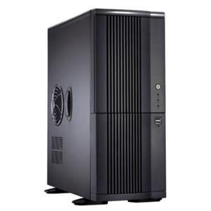
Experimental Setup
Input traffic
Processed packets
…
Packet generator
8 × 10 GbE links
PacketShader
(Up to 80 Gbps)
Notes:
For measurement, we connected a packet generator and PakcetShader back-to-back.
We built our own packet generator, which is based on our highly optimized packet I/O engine.
It can generate up to 80 Gbps with minimum sized UDP packets.

Slide 38
Results (w/ 64B packets)
GPU speedup
1.4x
4.8x
2.1x
3.5x
Notes:
Here is the result.
We implemented four applications, IPv4 and IPv6 forwarding, OpenFlow switch, and IPsec tunneling on top of PacketShader.
This graph compares our CPU-only and CPU+GPU implementations, clearly showing the effectiveness of GPU for packet processing.
The speedup due to GPU acceleration depends on applications.
For IPv4, which is simple enough already, so you can’t expect much improvement with GPU acceleration.
In contrast, IPv6 shows 4.8 times improvement over CPU-only implementation~
because IPv6 forwarding is highly memory-intensive so GPU can help a lot.
In this talk, I will give you more details of IPv6 and IPsec offloading as examples.

Slide 39
Example 1: IPv6 forwarding
Longest prefix matching on 128-bit IPv6 addresses
Algorithm: binary search on hash tables [Waldvogel97]
7 hashings + 7 memory accesses
…
…
…
…
Prefix length 1
64
80
96
128
Notes:
The first example is IPv6 forwarding.
IPv6 table lookup requires more processing power than IPv4~
because an IPv6 address is 128-bit long, which is 4 times longer than an IPv4 address.
So we offloaded the longest prefix matching operation to GPU.
The algorithm we used in our work performs binary search on hash tables.

Slide 40
Example 1: IPv6 forwarding
Bounded by motherboard IO capacity
(Routing table was randomly generated with 200K entries)
Notes:
Here is the performance result of IPv6 forwarding.
The performance improvement of GPU is clear when the packet size is small,
And our GPU acceleration guarantees around 40 Gbps for any packet sizes.
[click]
I told you that the total capacity of our system is 80 Gbps,
But for both CPU-only and CPU+GPU cases, the throughput does not scale beyond 40Gbps.
This is because of the hardware problem in our motherboard and details are again in the paper.
Neither CPU nor GPU is not the bottleneck, so we expect much higher performance once the hardware problem is fixed.

Slide 41
Example 2: IPsec tunneling
ESP (Encapsulating Security Payload) Tunnel mode
with AES-CTR (encryption) and SHA1 (authentication)
Original IP packet
IP header
IP payload
IP header
IP payload
+
ESP trailer
1. AES
ESP header
+
IP header
IP payload
ESP trailer
2. SHA1
IPsec Packet
New IP header
+
ESP header
IP header
IP payload
ESP trailer
ESP Auth.
Notes:
And the second example is IPsec tunneling.
IPsec tunneling is done in two stages.
In the first stage, the entire packet is encrypted with AES algorithm.
In the second stage, hash-based message authentication code is appended with SHA1 algorithm.
We offloaded AES and SHA1 algorithms to GPU because these cryptographic operations are highly compute-intensive.

Slide 42
Example 2: IPsec tunneling
3.5x speedup
Notes:
For Ipsec, GPU acceleration improves the throughput by a factor of 3.5.
You can see that the performance improvement is stable for all packet sizes.
This is because IPsec operates on entire packets, not only on packet headers.
For minimum sized packets PacketShader runs at 10 Gbps
and its performance reaches up to 20 Gbps for large packet sizes.
This performance is comparable or superior to commercial hardware-based VPN appliances.

Slide 43
Year | Ref. | H/W | IPv4 Throughput
2008 | Egi et al. | Two quad-core CPUs | 3.5 Gbps
2008 | “Enhanced SR” Bolla et al. | Two quad-core CPUs | 4.2 Gbps
2009 | “RouteBricks” Dobrescu et al. | Two quad-core CPUs (2.8 GHz) | 8.7 Gbps
2010 | PacketShader (CPU-only) | Two quad-core CPUs (2.66 GHz) | 28.2 Gbps
2010 | PacketShader (CPU+GPU) | Two quad-core CPUs + two GPUs | 39.2 Gbps
Kernel
User
Notes:
Let me compare our system with previous software routers.
PacketShader is the first multi-10G software router on a single machine,
And with GPU acceleration, PacketShader runs at the speed of 40 Gbps.
[click]
What’s interesting here is that previous software routers were implemented in kernel, not in user space.
The common belief has been that user-level packet processing, despite its many advantages, is much slower than kernel-level packet processing.
In contrast, we implemented PacketShader in user space, and shown that high-performance packet processing is possible in user space.
You can find many optimization techniques for user-level packet processing in the paper.

Slide 44
Conclusions
GPU
a great opportunity for fast packet processing
PacketShader
Optimized packet I/O + GPU acceleration
scalable with
# of multi-core CPUs, GPUs, and high-speed NICs
Current Prototype
Supports IPv4, IPv6, OpenFlow, and IPsec
40 Gbps performance on a single PC
Notes:
I am going to conclude this talk.
I have shown that GPU is a great opportunity for software routers.
We realized the GPU idea in the PacketShader.
PacketShader is a scalable software router,
which exploits GPU for packet processing acceleration on top of optimized packet I/O engine.
We implemented four applications, IPv4, v6, OpenFlow, and IPsec on PacketShader to prove the effectiveness and flexibility of our system.

Slide 45
Future Work
Control plane integration
Dynamic routing protocols with Quagga or Xorp
Multi-functional, modular programming environment
Integration with Click? [Kohler99]
Opportunistic offloading
CPU at low load
GPU at high load
Stateful packet processing
Notes:
Here is the list of our plan to extend PacketShader.
1. The first one is to integrate control plane in PacketShader.
Our current implementation only supports static forwarding tables for IP routing,
and we are planning to integrate Quagga or Xorp in our system.
2. The second one is about programming environment.
We are planning to support Click-like modular programming environment to make our system more extensible.
3. And the third one is to support the concept of opportunistic offloading.
If the volume of input traffic is low enough, then we may use only CPU for low latency and low power consumption.
And if the traffic level goes up, then we can use GPU for high throughput.
This is the end of my talk, and I would be happy to answer your questions. Thank you.

Slide 46
THANK YOU
Questions? (in CLEAR, SLOW, and EASY ENGLISH, please)
Personal AD (for professors):
I am a prospective grad student.
Going to apply this fall for my PhD study.
Less personal AD (for all):
Keon will present SSLShader in the poster session!

Slide 47
Backup slides

Slide 48
Latency: IPv6 forwarding

Slide 49
Packet I/O Performance

Slide 50
IPv4 Forwarding Performance

Slide 51
OpenFlow Forwarding Performance

Slide 52
Power consumption
Idle
Full load
260W
353W
327W
594W

Slide 53
Packet Reordering?
3. No reordering in GPU processing
Intra-flow: “No”
Shader
Device driver
Pre-shader
Post-shader
Device driver
1. Packets from the same flow go to the same worker
2. FIFO in the worker
Inter-flow: “Possibly yes”
Common in the Internet and not harmful

Slide 54
More CPUs vs. Additional GPUs (IPv6 example)
$2,000 4 Gbps
+ $4K + 4G
+ $10K + 8G
+ $0.5K + 16G
+ $1K + 30G

Slide 55
History of GPU Programmability
GPGPU = General-Purpose Computation on GPUs
Early-2000s
GPGPU Applications
Fixed graphics pipeline
little programmability
Limited
Mid-2000s
Programmable pipeline stages
Pixel shader and vertex shader
Emerging
(but requires expertise in graphics HW)
Late-2000s
Framework for general computation
Renaissance of parallel computing
Notes:
As GPUs have become more powerful, people thought:
“Wow, it’s cool. It would be nice if I can process my non-graphics problem on GPU”

Slide 56
CPU Bottleneck in Software Routers
Details in paper
Base OS overheads
1. Packet RX/TX via NICs
User interface
QoS
Access control
Multicast support
2. Core packet processing
Logging
Control plane operations
Accounting
Today’s topic
Notes:
CPU로 집중된다는 느낌이 전혀 안들어.
The bottleneck is in CPU.
These two are the major tasks done in software routers.
The first one is to pump up packets from input ports and then transmit them to output ports.
Because software routers have to handle tens of millions packets for every second, this task is highly intensive.
The second one is core packet processing.
Depending on applications, it may be forwarding table lookup, encryption, pattern matching, or whatever.
[click]
Along these two tasks, many operations are concentrated on CPU from accounting to dynamic routing protocol support, making the problem worse.
[click]
The details of our high-performance NIC device driver can be found in the paper.
In this presentation, I am going to talk about how we can accelerate core packet processing.

Slide 57
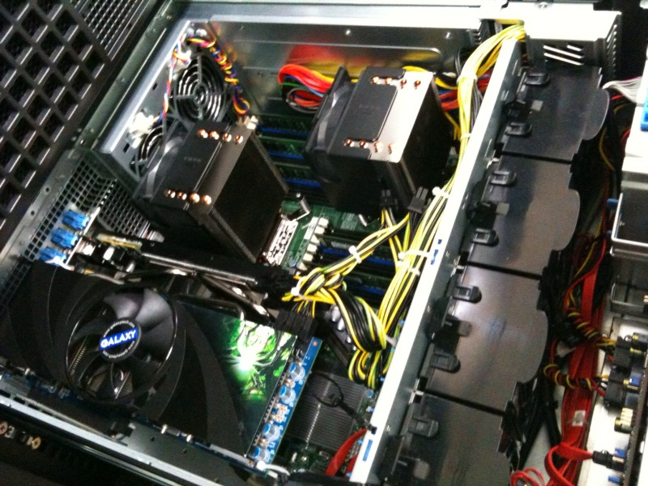
Hardware Setup
Two CPUs
RAM
RAM
RAM
CPU0
CPU1
RAM
RAM
RAM
NIC0,1
NIC4,5
IOH0
IOH1
NIC2,3
NIC6,7
Node 0
GPU0
GPU1
Node 1
10G port
PCIe x16
PCIe x8
QPI
GPU cost $500 × 2 = $1,000
Four dual-port NICs and two graphics cards
System total cost $7,000
Notes:
Sue: 복잡함

Slide 58
Applications of (Fast) Software Routers
For well-known protocols (e.g., IP routing)
Cost-effective replacement of traditional routers
For complex applications (e.g., intrusion detection)
PC-based network equipments
For Future Internet
Core component for deployment of new protocols
Into the real world beyond labs

Slide 59
Applications of Software Routers
Limitations (due to low performance)
For well-known protocols (e.g., IP routing)
Cost-effective replacement of traditional routers
Far behind the performance of traditional routers
For complex applications (e.g., intrusion detection)
PC-based network appliances
Limited deployment only in enterprise networks
For Future Internet
Core component for deployment of new protocols
Hard to get into real world beyond labs

Slide 60
OLD slides

Slide 61
Overview
PacketShader is a …
Scalable,
with multiple cores, CPUs, NICs, and GPUs
High-Performance
40+Gbps. The world’s first multi-10G software router.
Framework for
we implemented IPv4 and IPv6 routing, OpenFlow, and IPsec on it
General Packet Processing
provides a viable way towards high-performance software routers

Slide 62
In this talk, we do not address the details of
History of software routers
or
GPU & CUDA programming

Slide 63
INTRODUCTION

Slide 64
Software Routers
Flexible, but slow
Built on commodity PCs and software
Rather than ASICs, FPGAs, or network processors (NPs).
Good: Full programmability
To meet the ever-increasing demands for flexible traffic handling
Bad: Low performance
Known to be 1~5 Gbps
8.3 Gbps by RouteBricks for min-sized packets (SOSP ‘09)
CPU is the bottleneck
Packet I/O, packet processing, control plane, statistics, user-level interface, etc.)
We claim that GPU can be useful for packet processing.

Slide 65
GPU
= Graphics Processing Unit
Suitable for parallel, data-intensive workloads (pixels, vertices, …)
Widely being used for general-purpose computation
GTX285
Host Memory
NVIDIA GTX285
400$, 240 cores, 1GB memory,
1TFLOPs peak performance
GPU works in 3 steps
Memory copy: Host → Device
GPU kernel launch
(A kernel is a GPU program)
Memory copy: Device → Host
GPU
Streaming multiprocessor 29
32 GB/s
SP
SP
Register
(16K words)
CPU
Streaming multiprocessor 2
Streaming multiprocessor 1
SP
SP
QPI
25.6GB/s
SP
SP
Register
(16K words)
Streaming multiprocessor 0
SP
SP
Register
(16K words)
SP
SP
SP
Shared Memory
(16KB)
SP
IOH
SP
SP
Register
(16K words)
SP
SP
SP
SP
SP
SP
Shared Memory
(16KB)
SP
SP
SP
SP
Shared Memory
(16KB)
SP
SP
SP
SP
SP
Shared Memory
(16KB)
PCIe x16 (8GB/s)
SP
SP
SP
159 GB/s
Device Memory (1GB)

Slide 66
Data Transfer Rate
Between host memory and NVIDIA GTX285
➔ Unit transfer size must be big enough for GPU packet processing

Slide 67
GPU Kernel Launch Overhead
Additional threads add only marginal overhead
➔ Multiple packets should be processed at once on GPU

Slide 68
Definition: Chunk
Chunk (group of packets) is the basic processing unit of
packet I/O and
packet processing on GPU
In other words, chunk is used for batching and parallel packet processing.

Slide 69
Specification of Our Server
It reflects the trends of current and future commodity servers
Integrated memory controller and dual IOHs
Aggregate 80Gbps → the system must be highly efficient
8 CPU cores, 8 10G ports, 2 NUMA nodes, 2 GPUs, 2 IOH…
Scalability is the key

Slide 70
GPU Acceleration Alone Is Not Enough
Amdahl’s law says…
To accelerate compute-intensive workload such as IPsec, packet processing should be more efficient.
Can be done with GPUs.
To accelerate IO-intensive workload such as IPv4 routing, packet I/O should be more effective.
So we implement highly-optimized packet I/O engine.

Slide 71
Optimizing Packet I/O Engine

Slide 72
Inefficiencies of Linux Network Stack
Compact metadata
Batch processing
Huge packet buffer
Software prefetch
CPU cycle breakdown in packet RX

Slide 73
Huge Packet Buffer
eliminates per-packet buffer allocation cost
Linux per-packet buffer allocation
Our huge packet buffer scheme

Slide 74
User-space Packet Processing
Packet processing in kernel is bad
Kernel has higher scheduling priority; overloaded kernel may starve user-level processes.
Some CPU extensions such as MMX and SSE is not available.
Buggy kernel code causes irreversible damage to the system.
Processing in user-space is good
Rich, friendly development and debugging environment
Seamless integration with 3rd party libraries such as CUDA or OpenSSL
Easy to develop virtualized data plane.
But packet processing in user-space is known to be 3x times slower!
➔ Our solution: (1) batching + (2) better core-queue mapping

Slide 75
Batch Processing
amortizes per-packet bookkeeping costs.
Simple queuing theory; input traffic exceeds the capacity of the system → RX queues fills up
Dequeue and multiple packets multiple packets
It improves overall throughput

Slide 76
Effect of Batched Packet Processing
64-byte packets, two 10G ports, one CPU core
Without batching: 1.6 Gbps for RX, 2.1 Gbps for TX, 0.8 Gbps for forwarding
➔ batching is essential!

Slide 77
NUMA –aware RSS
RSS (Receive-Side Scaling) default behavior
RSS-enabled NICs distribute incoming packets into all CPU cores.
To save bandwidth between NUMA nodes, we prevent packets from crossing the NUMA boundary.
CPU cores
CPU cores
IOH
IOH
IOH
IOH
NIC
NIC
NIC
NIC

Slide 78
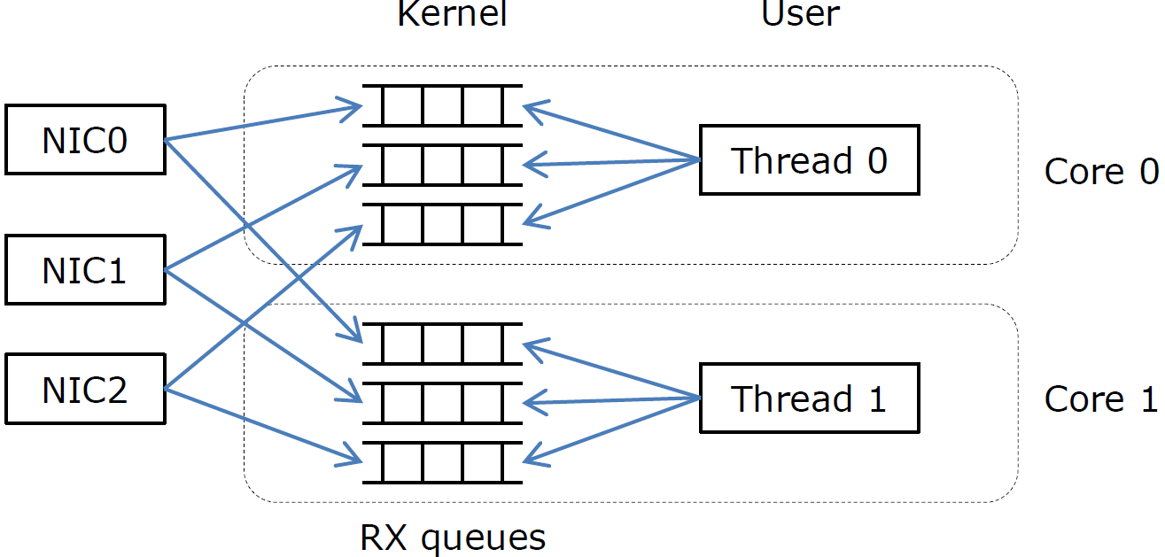
Multiqueue-Aware User-space Packet I/O
Existing scheme (ex. libpcap):
Per-NIC queues cause cache bouncing and lock contention
Our multiqueue-aware scheme:
Memory access is partitioned between cores

Slide 79
Packet I/O API
how to introduce chunk and multi-queue to user space
The device driver implements a special device /dev/packet_shader
User-space applications open and control the device via the ioctl() system call
High-level API functions wraps the ioctl() for convenience (see the table)

Slide 80
Packet I/O Performance

Slide 81
PacketShader

Slide 82
Master-Worker Scheme
In a CPU, we have 4 cores.
Each core has one dedicated thread.
3 cores run worker threads and 1 core for master thread
Worker thread
performs packet I/O and use the master thread as a proxy
Master thread
accelerates packet processing with GPU.

Slide 83
Workflow in PacketShader
In 3 steps
Preshading (Worker)
Receives a chunk, collects input data from packet headers or payloads
Shading (Master)
Actual packet processing with GPU
Data transfer between CPU and GPU
GPU kernel launch
Postshading (Worker)
transmits a chunk

Slide 84
How Master & Worker Threads Work
3 master threads and 1 worker thread example
Worker threads
Master thread
Per-worker queues to minimize sharing between cores
Single queue for fairness

Slide 85
NUMA Partitioning
PacketShader keep NUMA nodes as independently as possible.
Node 0
Only cores in the same CPU communicate to each other
Node 1
All memory allocation and access is done locally
Same policy in other nodes as well as Node 0
Core 0 Worker
Core 1 Worker
RAM
Core 2 Worker
Core 3 Master
RSS distributes packets into the cores in the same node
The master thread handles the GPU in the same node
NIC
NIC
GPU0
NIC
NIC
NUMA partitioning can improve the performance about 40%.
The only node-crossing operation in PacketShader is packet TX

Slide 86
Optimization 1: Chunk pipelining
avoids under-utilization of worker threads
Without pipelining: worker threads are under-utilized waiting for shading process
With pipelining: Worker threads can process other chunks rather than waiting

Slide 87
Optimization 2: Gather/Scatter
gives more parallelism to GPU
The more parallelism, the better GPU utilization
➔ Multiple chunks should be processed at once in the shading step

Slide 88
Optimization 3: Concurrent Copy & Execution
for better GPU utilization
Due to dependency, single chunk cannot utilize PCI-e bus and GPU at the same time
Data transfer and GPU kernel execution can overlap with multiple chunks
(up to 2x improvement in theory)
➔ In reality, CCE causes serious overhead (investigating why)

Slide 89
Applications

Slide 90
IPv4 Routing Throughput
(About 300K IPv4 routing prefixes from RouteView)

Slide 91
IPv6 Routing
Highly memory-intensive workload
Works with 128-bit IPv6 addresses
Much more difficult than IPv4 lookup (32 bits)
We adopt Waldvogel’s algorithm.
Binary search on the prefix length
7 memory access
Every memory access likely causes a cache miss
GPU can effectively hide memory latency with hundreds of threads

Slide 92
IPv6 Routing Throughput
(200K IPv6 routing prefixes are synthesized)

Slide 93
OpenFlow Switch
For flow-based switching for network experiments
OpenFlow controller
 | Field 1 | … | Field 10 | Action
1 | aaaa |  | aaa.a.aaa.aa | To port 4
2 | bbbb |  | bbb.bb.bbb.b | To port 2
Table update
Exact-match table
OpenFlow switch
 | Field 1 | … | Field 10 | Action | Priority
1 | xxxx |  | <any> | To port 2 | 1
2 | <any> |  | yy.y.y.yy | To port 3 | 2
Wildcard-match table
Extracts 10 fields in packet headers for flow matching
VLAN ID, MAC/IP addresses, port numbers, protocol number, etc.
Exact-match table
Specifies all 10 fields
Matching is done with Hash table lookup
Wildcard-match table
Specifies only some fields with priority
Linear search (with TCAM for hardware-based routers)
We offload wildcard match to GPU.

Slide 94
OpenFlow Throughput
With 64-byte packets, against various flow table sizes

Slide 95
IPsec Gateway
Highly compute-intensive
Widely used for VPN tunnels
AES for bulk encryption, SHA1 for HMAC
10x or more costly than forwarding plain packets
We parallelize input traffic in different ways on the GPU
AES at the byte-block level
SHA1 at the packet level

