Slide 1
Kargus: A Highly-scalable Software-based
Intrusion Detection System
M. Asim Jamshed*, Jihyung Lee†, Sangwoo Moon†, Insu Yun*,
Deokjin Kim‡, Sungryoul Lee‡, Yung Yi†, KyoungSoo Park*
* Networked & Distributed Computing Systems Lab, KAIST
† Laboratory of Network Architecture Design & Analysis, KAIST
‡ Cyber R&D Division, NSRI
Notes:
Remember to explain all graphical axes!!!!
Good morning:
My name is Asim Jamshed and I am here to discuss Kargus which is a highly-scalable software-based intrusion detection system.
It is a joint work between 3 labs and we are primarily based in KAIST.

Slide 2


Network Intrusion Detection Systems (NIDS)
Detect known malicious activities
  Port scans, SQL injections, buffer overflows, etc.
Deep packet inspection
  Detect malicious signatures (rules) in each packet
Desirable features
  High performance (> 10Gbps) with precision
  Easy maintenance
    Frequent ruleset updates
NIDS
Attack
Internet
Notes:
I will start off by briefly describing how an IDS works.
An IDS sits in front of target server machines and monitor packets for known malicious activities
IDS can be of 2 types: (i) signature-based, or (ii) anomaly-based.
We will focus on signature-based IDSes for this talk.
Signature-based IDSes employ DPI techniques to detect malicious attack signatures.
As the edge link bandwidth is exceeding 10 Gbps in today’s Internet, we ideally need an IDS to be
(i) high-performing, &
(ii) Easily maintainable, as in a network administrator should easily enable/disable an IDS feature.

Slide 3



Hardware vs. Software
H/W-based NIDS
  Specialized hardware
    ASIC, TCAM, etc.
  High performance
  Expensive
    Annual servicing costs
  Low flexibility
S/W-based NIDS
  Commodity machines
  High flexibility
  Low performance
    DDoS/packet drops
IDS/IPS Sensors
(10s of Gbps)
~ US$ 20,000 - 60,000
IDS/IPS M8000
(10s of Gbps)
~ US$ 10,000 - 24,000
Open-source S/W
≤ ~2 Gbps
Notes:
There are 2 types of IDSes….
Each have their own strengths and weaknesses.
H/W-based NIDS use customized hardware such as ASIC boards or TCAM memory.
As a result they show high performance…. however they cost a lot more and have low flexibility…. e.g.
it will be hard to enable/disable a feature (checksum) or add a new attack signature in it.
S/W-based NIDS uses commodity hardware. It has an easy programming/configuration interface. Unfortunately
they are low-performing (suitable for 1 Gbps) and are often short on resources. As a result they can become
vulnerable to DDoS attacks.

Slide 4
Goals
S/W-based NIDS
  Commodity machines
  High flexibility
  High performance
Notes:
Our goal in this talk is to improve the performance of the software-based IDS to such as extent that it performs as well as a hardware-based ids.

Slide 5
Typical Signature-based NIDS Architecture
alert tcp $EXTERNAL_NET any -> $HTTP_SERVERS 80
(msg:“possible attack attempt BACKDOOR optix runtime detection"; content:"/whitepages/page_me/100.html"; pcre:"/body=\x2521\x2521\x2521Optix\s+Pro\s+v\d+\x252E\d+\S+sErver\s+Online\x2521\x2521\x2521/")
Packet
Acquisition
Preprocessing
Multi-string Pattern Matching
Match
Success
Rule Options Evaluation
Evaluation
Success
Output
Decode
Flow management
Reassembly
Match Failure
(Innocent Flow)
Evaluation Failure
(Innocent Flow)
Malicious
Flow
Bottlenecks
* PCRE: Perl Compatible Regular Expression
Notes:
In order to understand where the S/W-based IDS faces bottlenecks, let’s review how a typical signature-based IDS works.
Once initialized, a packet passes through the IDS across the following modules.
Packet Acquisition module is responsible for fetching incoming packets. It then passes to the next module: preprocessing
The Preprocessing layer identifies the protocol of the packet.
It is also responsible for flow management (i.e. identifying the flow the packet belongs to) and packet
reassembly for elaborate signature analysis.
The next module is the start of the actual detection engine of the IDS.
Before I discuss this module… let’s have a look at an example attack signature rule. An IDS such as Snort has 1000s of such rules in its IDS.
The attack pattern starts with the “content” option. Only if the packet bears the attack string… the remaining options are evaluated.
This means the detection process works as a two-phase engine. The engine is designed as such due to 2 reasons:
An IDS such as Snort fetches all “content” rule options from the 1000s of rules and creates a large DFA based on the Aho-Corasick algorithm. This algo ensures the O(n) running time to match all multi-string attack patterns across the packet’s payload.
Secondly, most of the packets are normally innocuous, so they are bypassed after the first stage.
In the 2nd phase, the remaining rule options are evaluated. This may include a heavy regular expression evaluation process e.g. PCRE
Once all options of the signature are positive hits, the result of the attack is logged via the Output module.
As can be expected the modules that take major performance hits are PA, Multi-String… and ROE.
Please note that the entire NIDS engine in IDS such as Snort is single-threaded and it also processes packet one at a time.

Slide 6
Contributions
Goal
A highly-scalable software-based NIDS for high-speed network
Slow software NIDS
Fast software NIDS
Bottlenecks
Solutions
Inefficient packet acquisition
Multi-core packet acquisition
Expensive string &
PCRE pattern matching
Parallel processing &
GPU offloading
Fastest S/W signature-based IDS: 33Gbps
100% malicious traffic: 10 Gbps
Real network traffic: ~24 Gbps
Outcome
Notes:
Our major contributions have been the improving the performance of the packet acquisition and the pattern matching modules.
We will discuss in the coming slides how we improve the performance.
We introduce multi-core packet acquisition to improve reception.
We introduce GPU usage to facilitate parallel processing for pattern matching.
We also make a host of optimizations that makes Kargus the fastest S/W signature-based IDS we know.
Normal: 33 Gbps
100% malicious: 10 Gbps
Real network traffic: ~24 Gbps

Slide 7
Challenge 1: Packet Acquisition
Default packet module: Packet CAPture (PCAP) library
  Unsuitable for multi-core environment
  Low performing
  More power consumption
Multi-core packet capture library is required
Packet RX bandwidth*
0.4-6.7 Gbps
CPU utilization
100 %
[Core 1]
[Core 2]
[Core 3]
[Core 4]
[Core 5]
[Core 7]
[Core 8]
[Core 9]
[Core 10]
[Core 11]
10 Gbps NIC A
10 Gbps NIC B
10 Gbps NIC C
10 Gbps NIC D
* Intel Xeon X5680, 3.33 GHz, 12 MB L3 Cache
Notes:
Let’s discuss the first bottleneck that we face: Packet Acquisition
The most widely used library used to implement this module is PCAP.
It is known to have low performance because the packet has to go through a “heavy kernel TCP/IP stack”
that involves an intensive memory allocation and multiple packet copy operations.
Secondly, a PCAP handle created to read packets from a specific interface demands exclusive
access to the device i.e. two or more threads can’t read packets from a NIC at the same time.
Due to these reasons, the maximum packet reception performance we get per NIC is ~6.7 Gbps.
Since the reception is polling based, the CPU is also always 100% utilized.
What we need is a multi-core packet capture library

Slide 8
Solution: PacketShader I/O
PacketShader I/O
  Uniformly distributes packets based on flow info by RSS hashing
    Source/destination IP addresses, port numbers, protocol-id
  1 core can read packets from RSS queues of multiple NICs
  Reads packets in batches (32 ~ 4096)
Symmetric Receive-Side Scaling (RSS)
  Passes packets of 1 connection to the same queue
Packet RX bandwidth
0.4 - 6.7 Gbps
40 Gbps
[Core 1]
[Core 2]
[Core 3]
[Core 4]
[Core 5]
RxQ
A1
RxQ
B1
RxQ
A2
RxQ
B2
RxQ
A3
RxQ
B3
RxQ
A4
RxQ
B4
RxQ
A5
RxQ
B5
CPU utilization
100 %
16-29%
10 Gbps NIC A
10 Gbps NIC B
* S. Han et al., “PacketShader: a GPU-accelerated software router”, ACM SIGCOMM 2010
Notes:
We use PacketShader I/O (PSIO) for packet reception. This was first presented in SIGCOMM 2010. It exploits RSS and hardware queues that are present in all modern NICs today. The threads running on each core read packets from these queues. On packet reception, the NIC processor reads the flow information of the packet (i.e. SIP/DIP/SPORT/DPORT/PROT-ID) and computes a hash over these fields. Based on the result, the packets are dispatched to the respective hardware queue.
PSIO provides batching i.e…. And it saves context switches.
PSIO directly reads packets from the link layer… thus it prevents the packets from traversing the heavy TCP/IP kernel stack.

Slide 9
Challenge 2: Pattern Matching
CPU intensive tasks for serial packet scanning
Major bottlenecks
  Multi-string matching (Aho-Corasick phase)
  PCRE evaluation (if ‘pcre’ rule option exists in rule)
On an Intel Xeon X5680, 3.33 GHz, 12 MB L3 Cache
  Aho-Corasick analyzing bandwidth per core: 2.15 Gbps
  PCRE analyzing bandwidth per core: 0.52 Gbps
Notes:
The next major bottleneck the IDS faces is the pattern matching because they are high CPU intensive tasks.
We ran microbenchmarks on our system that was an Intel Xeon X5680, 3.33 GHz and we found that Aho-Corasick performance per core is only 2.15 Gbps while PCRE bandwidth is 0.52 Gbps.

Slide 10
Solution: GPU for Pattern Matching
GPUs
  Containing 100s of SIMD processors
    512 cores for NVIDIA GTX 580
  Ideal for parallel data processing without branches
DFA-based pattern matching on GPUs
  Multi-string matching using Aho-Corasick algorithm
  PCRE matching
Pipelined execution in CPU/GPU
  Concurrent copy and execution
Aho-Corasick bandwidth
2.15 Gbps
39 Gbps
PCRE bandwidth
0.52 Gbps
8.9 Gbps
Engine Thread
GPU
Packet Acquisition
Preprocess
Multi-string
Matching
Rule Option
Evaluation
Multi-string
Matching
Offloading
Offloading
PCRE
Matching
GPU Dispatcher Thread
Multi-string Matching Queue
PCRE Matching Queue
Notes:
Let’s look at how we optimize the signature detection engine.
GPU is used best for modules that have less branched statements as it has few transistors allocated for control registers.
During initialization, Kargus creates Aho-Corasick DFA and converts PCRE to DFAs using the sequence of Thompson’s algorithm and subset construction algorithm. It then copies them to GPU texture memory so that these modules…. (that have few branched statements) can also run in GPU in parallel.
Since GTX 580 has 512 cores and we have 2 of them in our system…. our system is bound to kick ass.
- We use standard GPU vendor-provided techniques such as concurrent copy and execution that guarantees that GPU I/O operations and GPU packet processing tasks happen simultaneously to avoid GPU from going idle.

Slide 11
Optimization 1: IDS Architecture
How to best utilize the multi-core architecture?
Pattern matching is the eventual bottleneck
Run entire engine on each core
Function | Time % | Module
acsmSearchSparseDFA_Full | 51.56 | multi-string matching
List_GetNextState | 13.91 | multi-string matching
mSearch | 9.18 | multi-string matching
in_chksum_tcp | 2.63 | preprocessing
* GNU gprof profiling results
Notes:
Now that we have introduced 2 major performance enhancing updates to our system, we focus our attention on the optimal layout of Kargus in a multi-core machine.
We realize that the pattern matching is still the most CPU intensive task
Therefore, we decide to use all the cores to run independent IDS engines.

Slide 12
Solution: Single-process Multi-thread
Runs multiple IDS engine threads & GPU dispatcher threads concurrently
  Shared address space
  Less GPU memory consumption
  Higher GPU utilization & shorter service latency
GPU memory usage
1/6
Core 6
Single thread pinned at core 1
GPU Dispatcher Thread
Rule
Option
Evaluation
Rule
Option
Evaluation
Rule
Option
Evaluation
Rule
Option
Evaluation
Rule
Option
Evaluation
Multi-string
Matching
Multi-string
Matching
Multi-string
Matching
Multi-string
Matching
Multi-string
Matching
Preprocess
Preprocess
Preprocess
Preprocess
Preprocess
Packet Acquisition
Packet Acquisition
Packet Acquisition
Packet Acquisition
Packet Acquisition
Core 1
Core 2
Core 3
Core 4
Core 5
Notes:
We adopt a single-process, multi-threaded approach
As the system is hexacore… we have 5 mini-IDS engines running on each node. They work completely independent of each other. i.e. they don’t exchange packets between each other.
One core is used to talk to the GPU (GPU Manager)
All engines are pinned to their dedicated cores to prevent packet migration that can lead to expensive cache bouncing effects.
By making it single-process all threads share a common address space which also means that al engines get to share a common GPU context and common DFA tables for Aho-Corasick and PCRE state machines. This leads to less GPU mem consumption and higher GPU utilization.
We save GPU memory by 1/6 th since we are using a hexanode system

Slide 13
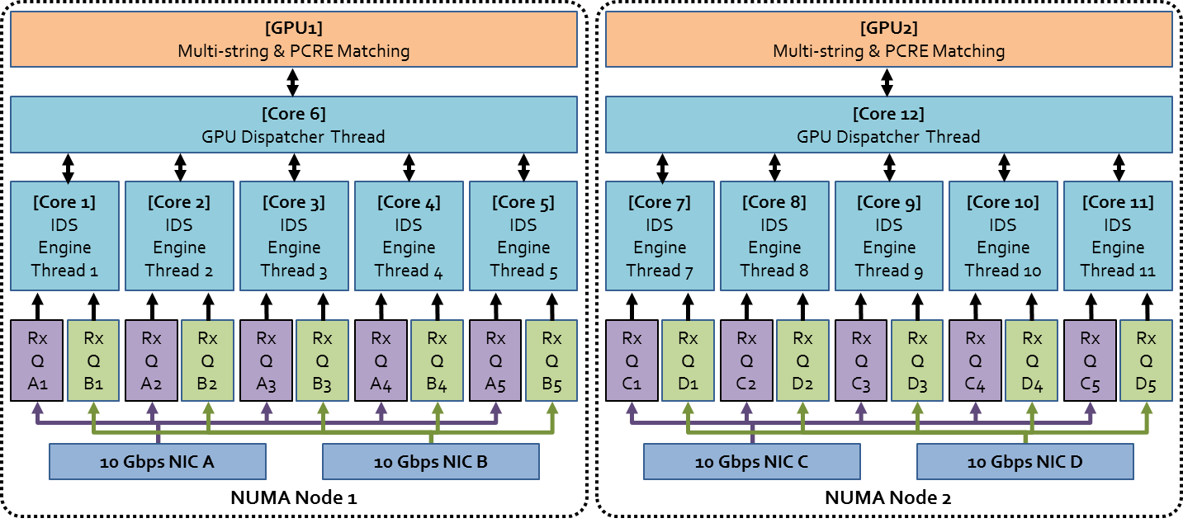
Architecture
    Non Uniform Memory Access (NUMA)-aware
Core framework as deployed in dual hexa-core system
Can be configured to various NUMA set-ups accordingly
▲ Kargus configuration on a dual NUMA hexanode machine having 4 NICs, and 2 GPUs
Notes:
This is how are IDS looks like. We exploit NUMA architecture of our system…. Which means that engines running on 1 NUMA node only access LOCAL NICs and GPU for operations.

Slide 14
Optimization 2: GPU Usage
Caveats
  Long per-packet processing latency:
    Buffering in GPU dispatcher
  More power consumption
    NVIDIA GTX 580: 512 cores
Use:
  CPU when ingress rate is low (idle GPU)
  GPU when ingress rate is high
Notes:
We realize that relying on GPU is not always optimal as packets may incur heavy processing latencies due to buffering as packets are passed in batches to GPU
Moreover, a GPU has 100s of GPU processing cores that consume a LOT of power

Slide 15
Solution: Dynamic Load Balancing
Load balancing between CPU & GPU
  Reads packets from NIC queues per cycle
  Analyzes smaller # of packets at each cycle (a < b < c)
  Increases analyzing rate if queue length increases
  Activates GPU if queue length increases
Packet latency with
GPU : 640 μsecs
CPU: 13 μsecs
a
b
c
Internal packet queue (per engine)
CPU
CPU
GPU
GPU
Queue
Length
α
β
γ
a
b
c
Notes:
In order to improve this:
We came up with a dynamic load balancing algo.
We create an internal packet queue right after the packet acquisition module for each engine.
Every time the engine gets batch of packets from the packet acquisition module, they are en-queued in this queue and during that cycle, only `a’ number of pkts per cycle are analyzed. If the incoming rate is low, this queue will always stay in the ‘CPU’ zone. However, if the queue length gets filled up (due to high incoming rate > 20 Gbps) to `beta’,
we enable the GPU and also increase the per-cycle analyzing chunk to `b’.
Once the incoming packet arrival rate lowers down… we reverse these parameters.
With

Slide 16
Optimization 3: Batched Processing
Huge per-packet processing overhead
  > 10 million packets per second for small-sized packets at 10 Gbps
  reduces overall processing throughput
Function call batching
  Reads group of packets from RX queues at once
  Pass the batch of packets to each function
Decode(p) → Preprocess(p) → Multistring_match(p)
Decode(list-p) → Preprocess(list-p) → Multistring_match(list-p)
2x faster processing rate
Notes:
Our last optimization technique is specific to per-packet processing overhead.
For small-packet sizes, a network interface can potentially get over 10 million packets per second.
Making repeated function calls for every packet across the IDS can reduce overall processing throughput due to repeated activation record creations and deletions.
We introduce function call batching in which group of packets are passed from function to function.
As a result we get twice as fast performance for small-sized packets

Slide 17
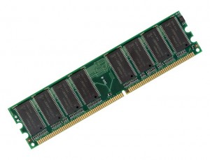
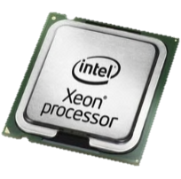
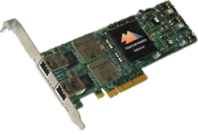
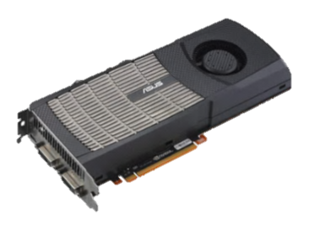
Kargus Specifications
12 GB DRAM (3GB x 4)
Intel X5680 3.33 GHz (hexacore)
12 MB L3 NUMA-Shared Cache
$100
$1,210
NUMA node 1
NUMA node 2
NVIDIA GTX 580 GPU
$370
$512
Total Cost
(incl. serverboard) = ~$7,000
Intel 82599 Gigabit Ethernet Adapter (dual port)
Notes:
Time to evaluate our system.
We were using a dual-hexanode system. It was an Intel X5680 3.33GHz machine with 12 MB L3 cache.
We were using Intel 82599 dual-port 10Gbps Ethernet adapters.
We also used NVIDIA GTX 580 cards for each NUMA node

Slide 18
IDS Benchmarking Tool
Generates packets at line rate (40 Gbps)
  Random TCP packets (innocent)
  Attack packets are generated by attack rule-set
Support packet replay using PCAP files
Useful for performance evaluation
Notes:
We created our own IDS benchmarking tool that uses PSIO
It is capable of producing random as well as attack packets as read from Snort rule file.
It can also replay actual pcap trace files.
- Please note that this tool is only used to perform benchmarking analysis

Slide 19
Kargus Performance Evaluation
Micro-benchmarks
  Input traffic rate: 40 Gbps
  Evaluate Kargus (~3,000 HTTP rules) against:
    Kargus-CPU-only (12 engines)
    Snort with PF_RING
    MIDeA*
Refer to the paper for more results
* G. Vasiliadis et al., “MIDeA: a multi-parallel intrusion detection architecture”, ACM CCS ‘11
Notes:
We test Kargus with 3 other prototypes:
We have kargus where GPUs are disabled.
We have Snort instance running on all 12 cores with Pf_RING library
And we have MIDeA numbers. We could not get MIDeA software. We normalized their results to our machine.
MIDeA is the previous state-of-the-art IDS solution that was presented @ CCS 2011. It uses PF_RING (that uses hardware queues but their I/O is polling based), and is a process-based system… i.e. it has 10 processes running on each core. This leads to excessive memory consumption.

Slide 20
Innocent Traffic Performance
2.7-4.5x faster than Snort
1.9-4.3x faster than MIDeA
Actual payload analyzing bandwidth
Notes:
We find out that Kargus outperforms all other prototypes. It shows 4.3x times better performance than MIDeA and 4.5x better performance than Snort.
One thing to note is that in case of 64 B pkts case… the analyzing bandwidth is very high. This is because majority of the packet (54B) per packet is made of headers… so very little time is spent in the analyzing module… thus the performance is very good.

Slide 21
Malicious Traffic Performance
5x faster than Snort
Notes:
EXPLAIN Y-AXIS. EXPLAIN ABOUT %AGE
When these prototypes are tested against different concentrations of attack packets… our results are even more impressive.
Kargus performs higher than 10 Gbps for 100% malicious traffic even in the worst case.

Slide 22
Real Network Traffic
Three 10Gbps LTE backbone traces of a major ISP in Korea:
  Time duration of each trace: 30 mins ~ 1 hour
  TCP/IPv4 traffic:
    84 GB of PCAP traces
    109.3 million packets
    845K TCP sessions
Total analyzing rate: 25.2 Gbps
  Bottleneck: Flow Management (preprocessing)
Notes:
We also tested Kargus with real network traces.
We were able to get hold of 3 10 Gbps backbone traces of 30mins ~ 1 hour long duration
They were 84 GB of pcap traces containing 109.3 million packets
They consisted of 845K TCP sessions
The total analyzing rate was 25.2 Gbps

Slide 23
Effects of Dynamic GPU Load Balancing
Varying incoming traffic rates
  Packet size = 1518 B
20%
8.7%
Power Consumption (Watts)
Offered Incoming Traffic (Gbps) [Packet Size: 1518 B]
Notes:
Let’s evaluate this algorithm…shall we?
We use the same set of hardware.
We run our IDS in 3 modes against packets coming at different incoming rates.
-→ 1 in which Kargus has load-balancing disabled and the PSIO is set to polling mode. This is our base case.
This shows the worst performance and we can see it shows power consumption as high as 33 Gbps.
In the 2nd mode, we have PSIO set as interrupt-driven. It shows better performance for lower input rates as the engine spends more time in blocking mode.
The power reading in 33 Gbps is essentially the same as the system is always busy analyzing packets.
Now once we have a fully functional IDS running with load balancing enabled…. We see that it consumes least power for 20 Gbps reading.
Why 20 Gbps point is good discussion point (CPU)? Explain (if you are asked).

Slide 24

Conclusion
Software-based NIDS:
  Based on commodity hardware
    Competes with hardware-based counterparts
  5x faster than previous S/W-based NIDS
  Power efficient
  Cost effective
> 25 Gbps (real traffic)
> 33 Gbps (synthetic traffic)
US $~7,000/-
Notes:
Batching
33 Gbps

Slide 25


Thank You
fast-ids@list.ndsl.kaist.edu
https://shader.kaist.edu/kargus/

Slide 26
Backup Slides

Slide 27
Kargus vs. MIDeA
UPDATE | MIDEA | KARGUS | OUTCOME
* G. Vasiliadis, M.Polychronakis, and S. Ioannidis, “MIDeA: a multi-parallel intrusion detection architecture”, ACM CCS 2011
Notes:
MIDeA (as was discussed earlier) was presented last year.
We decided to show you how that Kargus is noticeably different from all predecssors

Slide 28
Kargus vs. MIDeA
UPDATE | MIDEA | KARGUS | OUTCOME
Packet acquisition | PF_RING | PacketShader I/O | 70% lower CPU utilization
* G. Vasiliadis, M.Polychronakis, and S. Ioannidis, “MIDeA: a multi-parallel intrusion detection architecture”, ACM CCS 2011
Notes:
MIDeA (as was discussed earlier) was presented last year.
We decided to show you how that Kargus is noticeably different from all predecssors

Slide 29
Kargus vs. MIDeA
UPDATE | MIDEA | KARGUS | OUTCOME
Packet acquisition | PF_RING | PacketShader I/O | 70% lower CPU utilization
Detection engine | GPU-support for Aho-Corasick | GPU-support for Aho-Corasick & PCRE | 65% faster detection rate
* G. Vasiliadis, M.Polychronakis, and S. Ioannidis, “MIDeA: a multi-parallel intrusion detection architecture”, ACM CCS 2011
Notes:
MIDeA (as was discussed earlier) was presented last year.
We decided to show you how that Kargus is noticeably different from all predecssors

Slide 30
Kargus vs. MIDeA
UPDATE | MIDEA | KARGUS | OUTCOME
Packet acquisition | PF_RING | PacketShader I/O | 70% lower CPU utilization
Detection engine | GPU-support for Aho-Corasick | GPU-support for Aho-Corasick & PCRE | 65% faster detection rate
Architecture | Process-based | Thread-based | 1/6 GPU memory usage
* G. Vasiliadis, M.Polychronakis, and S. Ioannidis, “MIDeA: a multi-parallel intrusion detection architecture”, ACM CCS 2011
Notes:
MIDeA (as was discussed earlier) was presented last year.
We decided to show you how that Kargus is noticeably different from all predecssors

Slide 31
Kargus vs. MIDeA
UPDATE | MIDEA | KARGUS | OUTCOME
Packet acquisition | PF_RING | PacketShader I/O | 70% lower CPU utilization
Detection engine | GPU-support for Aho-Corasick | GPU-support for Aho-Corasick & PCRE | 65% faster detection rate
Architecture | Process-based | Thread-based | 1/6 GPU memory usage
Batch processing | Batching only for detection engine (GPU) | Batching from packet acquisition to output | 1.9x higher throughput
* G. Vasiliadis, M.Polychronakis, and S. Ioannidis, “MIDeA: a multi-parallel intrusion detection architecture”, ACM CCS 2011
Notes:
MIDeA (as was discussed earlier) was presented last year.
We decided to show you how that Kargus is noticeably different from all predecssors

Slide 32
Kargus vs. MIDeA
UPDATE | MIDEA | KARGUS | OUTCOME
Packet acquisition | PF_RING | PacketShader I/O | 70% lower CPU utilization
Detection engine | GPU-support for Aho-Corasick | GPU-support for Aho-Corasick & PCRE | 65% faster detection rate
Architecture | Process-based | Thread-based | 1/6 GPU memory usage
Batch processing | Batching only for detection engine (GPU) | Batching from packet acquisition to output | 1.9x higher throughput
Power-efficient | Always GPU (does not offload only when packet size is too small) | Opportunistic offloading to GPUs (Ingress traffic rate) | 15% power saving
* G. Vasiliadis, M.Polychronakis, and S. Ioannidis, “MIDeA: a multi-parallel intrusion detection architecture”, ACM CCS 2011
Notes:
MIDeA (as was discussed earlier) was presented last year.
We decided to show you how that Kargus is noticeably different from all predecssors

Slide 33
Receive-Side Scaling (RSS)
RSS uses Toeplitz hash function (with a random secret key)
Algorithm: RSS Hash Computation
function ComputeRSSHash(Input[], RSK) ret = 0; for each bit b in Input[] do if b == 1 then ret ^= (left-most 32 bits of RSK); endif shift RSK left 1 bit position; end for end function

Slide 34
Symmetric Receive-Side Scaling
Update RSK (Shinae et al.)
0x6d5a | 0x56da | 0x255b | 0x0ec2
0x4167 | 0x253d | 0x43a3 | 0x8fb0
0xd0ca | 0x2bcb | 0xae7b | 0x30b4
0x77cb | 0x2d3a | 0x8030 | 0xf20c
0x6a42 | 0xb73b | 0xbeac | 0x01fa
0x6d5a | 0x6d5a | 0x6d5a | 0x6d5a
0x6d5a | 0x6d5a | 0x6d5a | 0x6d5a
0x6d5a | 0x6d5a | 0x6d5a | 0x6d5a
0x6d5a | 0x6d5a | 0x6d5a | 0x6d5a
0x6d5a | 0x6d5a | 0x6d5a | 0x6d5a

Slide 35
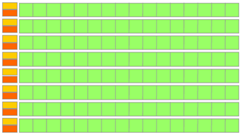
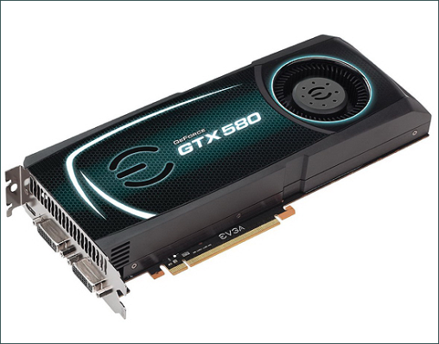
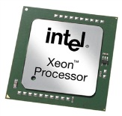
Why use a GPU?
Control
ALU
ALU
ALU
ALU
VS
ALU
ALU
ALU
Cache
Xeon X5680:
6 cores
GTX 580:
512 cores
*Slide adapted from NVIDIA CUDA C A Programming Guide Version 4.2 (Figure 1-2)

Slide 36
GPU Microbenchmarks – Aho-Corasick
39 Gbps
2.15 Gbps

Slide 37
GPU Microbenchmarks – PCRE
8.9 Gbps
0.52 Gbps

Slide 38
Effects of NUMA-aware Data Placement
Use of global variables minimal
  Avoids compulsory cache misses
  Eliminates cross-NUMA cache bouncing effects
Performance Speedup
1518
Packet Size (Bytes)

Slide 39
CPU-only analysis for small-sized packets
Offloading small-sized packets to the GPU is expensive
  Contention across page-locked DMA accessible memory with GPU
  GPU operational cost of packet metadata increases
82

Slide 40
Challenge 1: Packet Acquisition
Default packet module: Packet CAPture (PCAP) library
  Unsuitable for multi-core environment
  Low Performing
Notes:
We use PacketShader I/O (PSIO) for reading packets. This is the current state-of-the-art I/O library that uses RSS to establish load-balanced distribution of packets across all NIC queues. It uses a hash function over IP addrs, protocol # and port numbers as part of the seed to uniformly divide packets amongst queues. We use a symmetric version (acknowledge Shinae) of RSS to ensure that packets of a single bidirectional flow end up in the same queue.
Since each queue is bound to a specific core… a specific engine will be able to analyze all packets of the same flow.
Additional Info for novices….
RSS algo is done inside NIC
Hardware queues are inside NIC
PSIO provides batching i.e…. And it saves context switches.
PSIO directly reads packets from the link layer… thus it prevents the packets from traversing the heavy TCP/IP kernel stack.

Slide 41
Solution: PacketShader* I/O
Notes:
We use PacketShader I/O (PSIO) for reading packets. This is the current state-of-the-art I/O library that uses RSS to establish load-balanced distribution of packets across all NIC queues. It uses a hash function over IP addrs, protocol # and port numbers as part of the seed to uniformly divide packets amongst queues. We use a symmetric version (acknowledge Shinae) of RSS to ensure that packets of a single bidirectional flow end up in the same queue.
Since each queue is bound to a specific core… a specific engine will be able to analyze all packets of the same flow.
Additional Info for novices….
RSS algo is done inside NIC
Hardware queues are inside NIC
PSIO provides batching i.e…. And it saves context switches.
PSIO directly reads packets from the link layer… thus it prevents the packets from traversing the heavy TCP/IP kernel stack.

